Slide 1
Numerical simulation and experimental study of a micro circulating fluidized bed
Yupeng Xu, Jordan Musser, Tingwen Li, Balaji Gopalan, Rupen Panday, Jonathan Tucker, Greggory Breault, William A. Rogers
Month 31, 2016

Slide 2
Outline
Validation of MFIX-DEM for full-loop CFB systems
Direct comparison between simulation and experiments in a small-scale full-loop circulating fluidized bed
Conclusions and future work

Slide 3
Motivation
Circulating fluidized beds (CFB) are deployed in industry for a wide variety of gas-solid contacting operations.
Numerical simulations of full-loop CFB hydrodynamics at particle-scale are extremely useful to understand flow behaviors that are crucial in the design and operation of systems, including particle residence time distribution and cluster formation.
A thorough comparison between computational predications and experimental measurements is necessary to evaluate the accuracy of computational models.

Slide 4
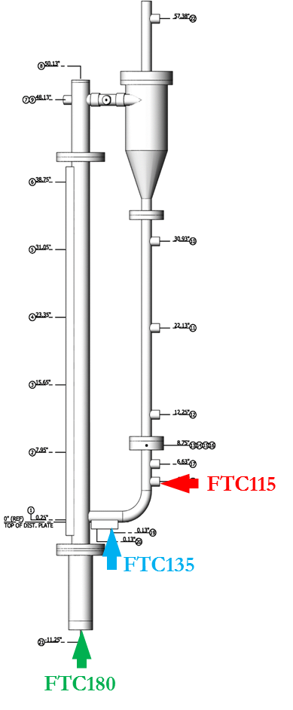
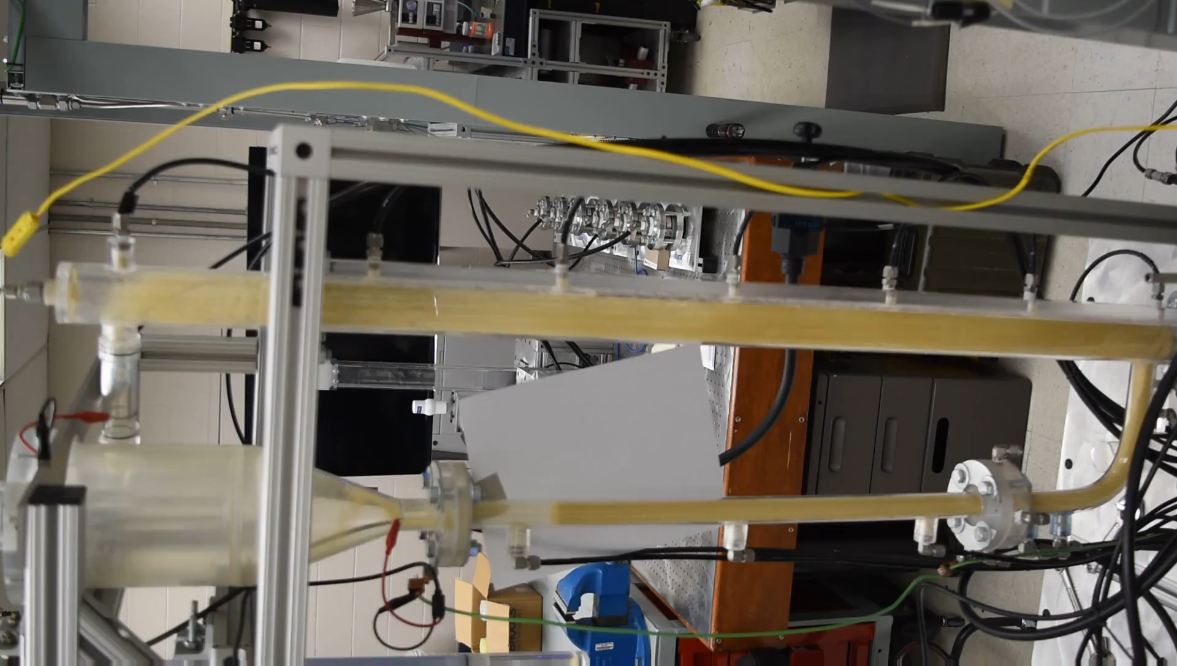
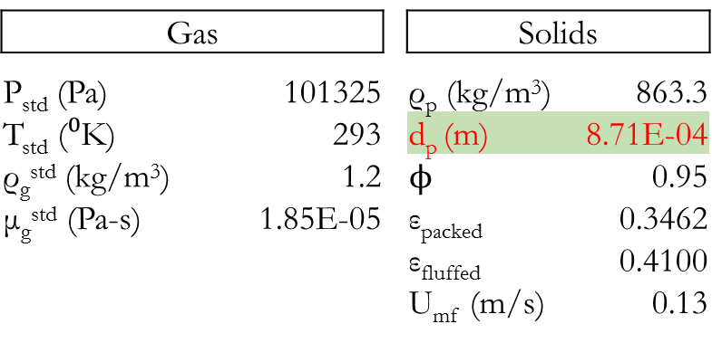
Experiments
Multiphase Flow Analysis Laboratory (MFAL)
A cold-flow CFB of 1.32m high is used. The internal diameters of the cyclone, riser and standpipe are 0.127m, 0.0508m and 0.0254m, respectively. Three conditions are tested with operational parameters listed in Table 1.
Experimental setup
Operation conditions (SLPM)

Slide 5
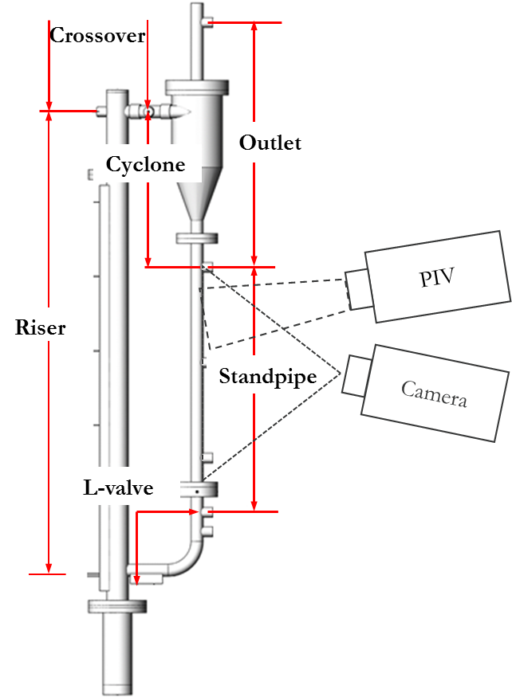
Experimental techniques
Multiphase Flow Analysis Laboratory (MFAL)
Pressure drop
Solids circulation rate
The solids flux was measured using High speed Particle Image Velocimetry (HsPIV) developed by NETL.
Low solid fluxes were measured by directly counting the number of particles that crossed a section of standpipe within a set time.
Higher solid fluxes were calculated from measured velocity and estimated concentration using the high-speed video from HsPIV and an in-house calibration procedure.
The measurement technique was validated in a half scale CFB facility where the L-valve was separated from the standpipe. In this configuration, particles fell onto a scale and were weighed directly.
Measurement accuracy was determined to be ± 1% for low solids flux and ± 15% for higher solids fluxes..
Standpipe bed height

Slide 6
Simulation approach
Multiphase Flow with Interphase eXchanges-Discrete Element Model (MFIX-DEM)
Cartesian grids are used to discretize the computational domain.
Cut-cell technique is use for boundary cells to resolve the geometry.
Hybrid parallel mode using message passing interface (MPI) and open multi-processing (OpenMP).
(a) (b) (c) (d)

Slide 7
Simulation strategy
A roadmap for this study
Grid size selection
Statistical time determination
Calibration (drag model)
Wen & Yu
Gidaspow
BVK
HKL
Detailed comparison
Influence of the PSD
Further exploration

Slide 8
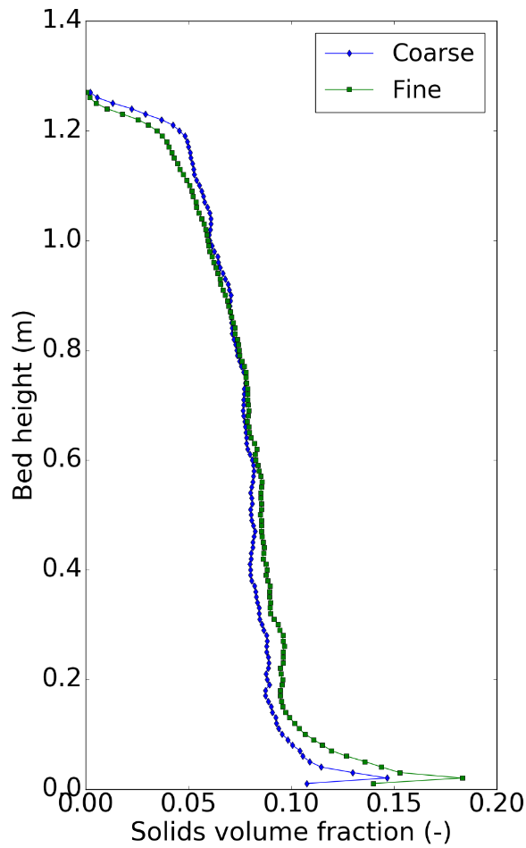
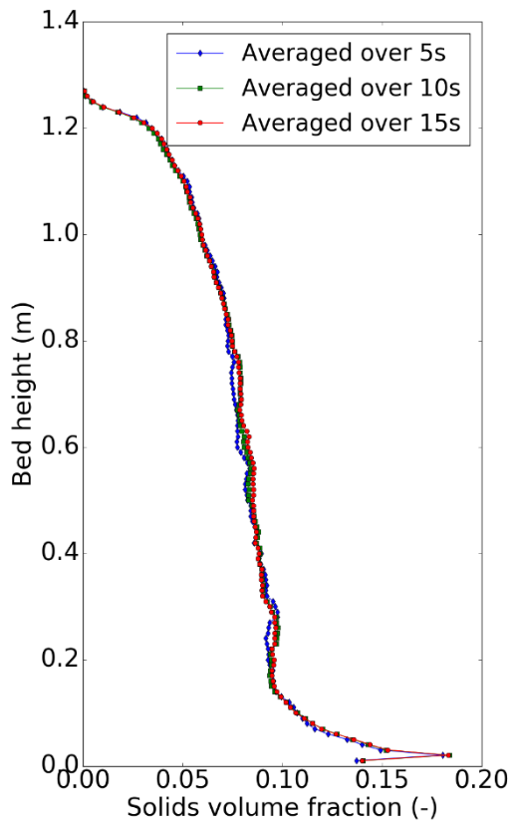
Results
Grid size and statistical time selection
 | X (W) | Y (H) | Z (D)
 | 0.32 m | 1.32 m | 0.15 m
Fine | 80 | 330 | 38
Coarse | 40 | 165 | 20
15 s
10 s
10 s
5 s
Y
Z
X

Slide 9
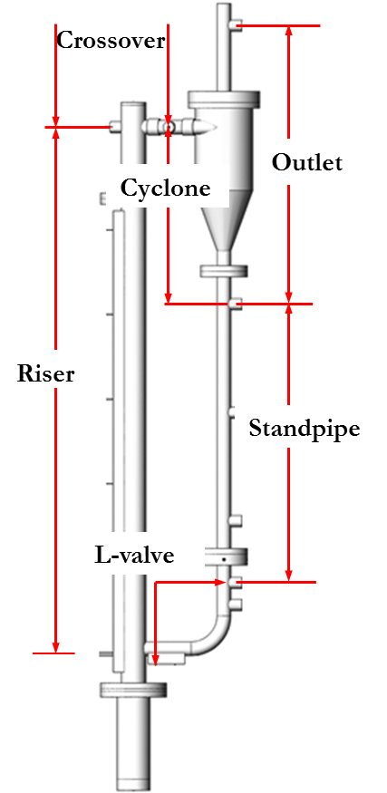
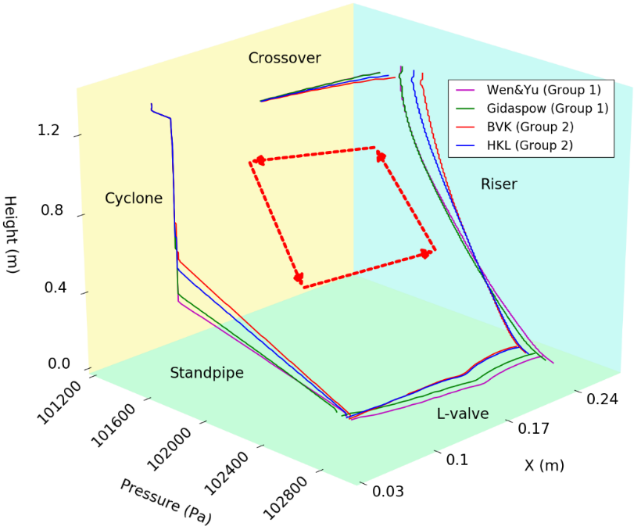
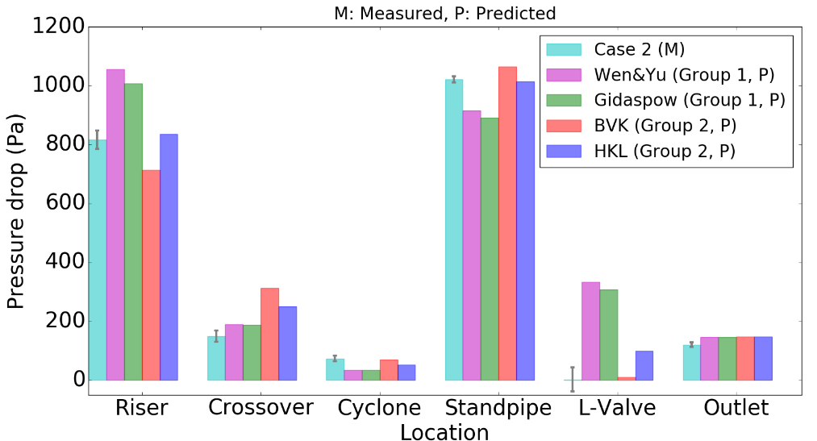
Results
Selection of drag law

Slide 10
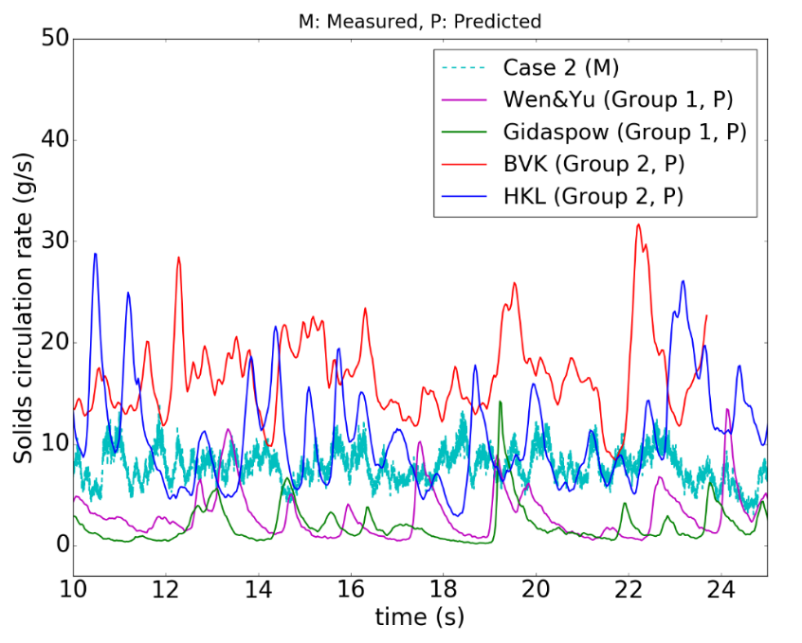
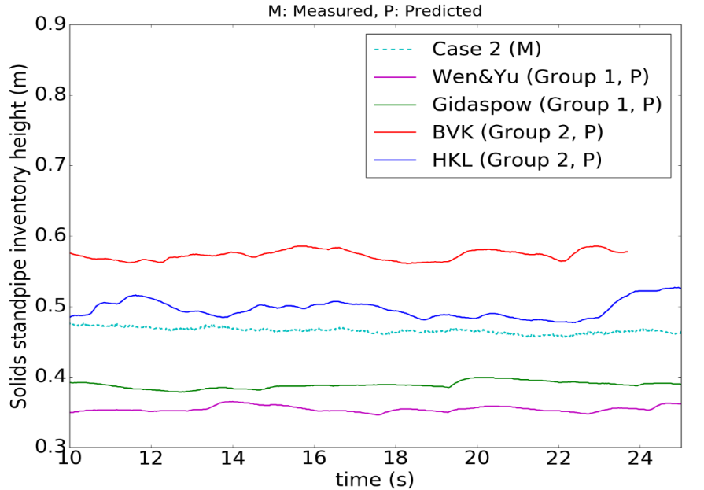
Results
Selection of drag law
Solids circulation rate
Solids standpipe inventory height
 |  | Circulation Rate (g/s)
 | Experiment | 6.8 +/- 1.5
Group 1 | Wen & Yu | 2.99
 | Gidaspow | 2.17
Group 2 | BVK | 16.9
 | HKL | 10.38
 |  | Solids standpipe inventory height (m)
 | Experiment | 0.47 +/- 0.02
Group 1 | Wen & Yu | 0.36
 | Gidaspow | 0.39
Group 2 | BVK | 0.57
 | HKL | 0.50

Slide 11
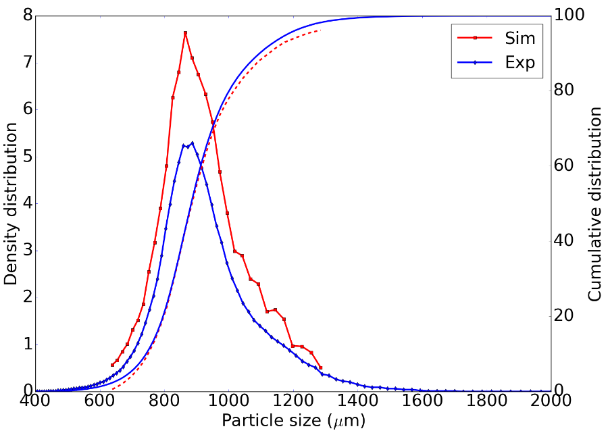
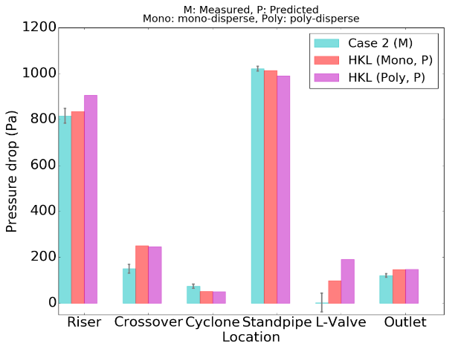
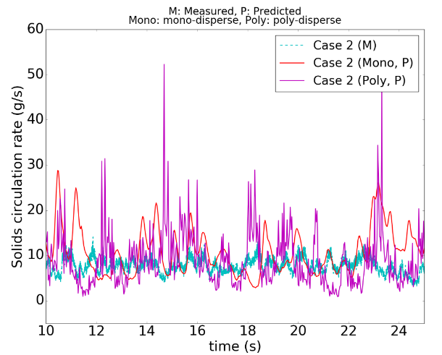
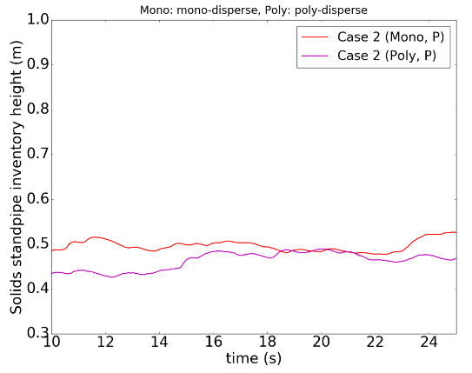
Results
Influence of the particle size distribution
HDPE, Geldart B

Slide 12
Results
Detailed comparison (Visualization)
Case 1
Case 2
Case 3

Slide 13
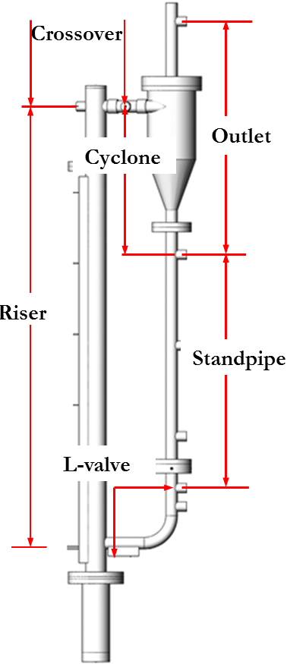
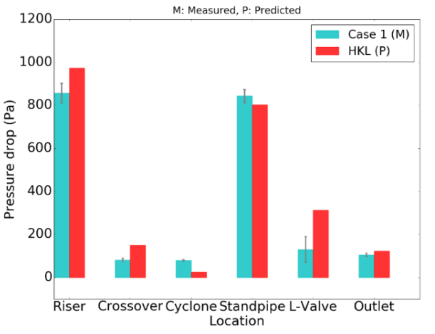
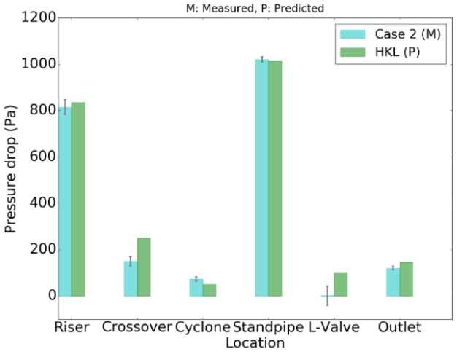
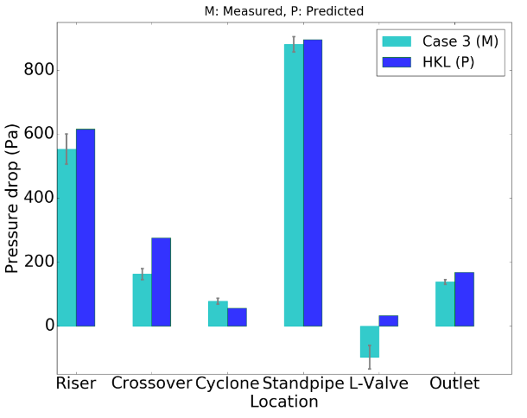
Results
Detailed comparison (pressure drop)
Table 1. Operation conditions (SLPM)
Case 1
Case 2
Case 3

Slide 14
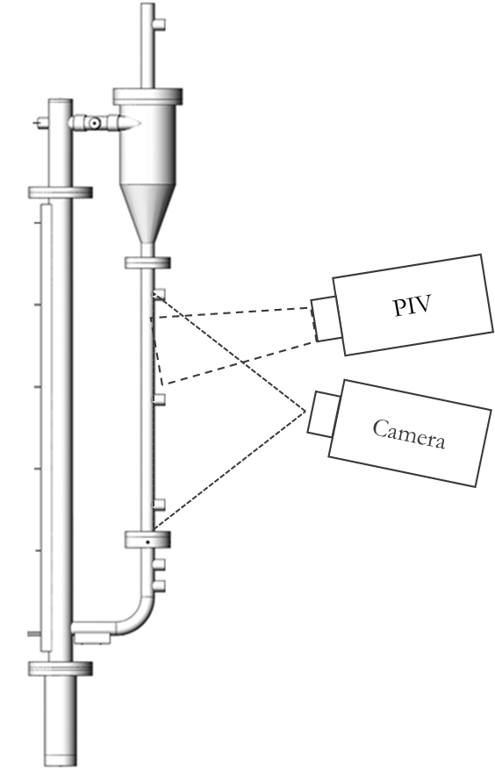
Results
Detailed comparison (Solids circulation rate & Standpipe bed height)
Solids circulation rate
 |  | Experiment | Simulation
Solids circulation rate (g/s) | Case 1 | 0.06±0.1 | 0.36
 | Case 2 | 6.8±1.5 | 10.38
 | Case 3 | 7.9±1.5 | 10.66
Standpipe bed height
 |  | Experiment | Simulation
Standpipe bed height (m) | Case 1 | 0.43 | 0.42
 | Case 2 | 0.47 | 0.50
 | Case 3 | 0.65 | 0.68

Slide 15
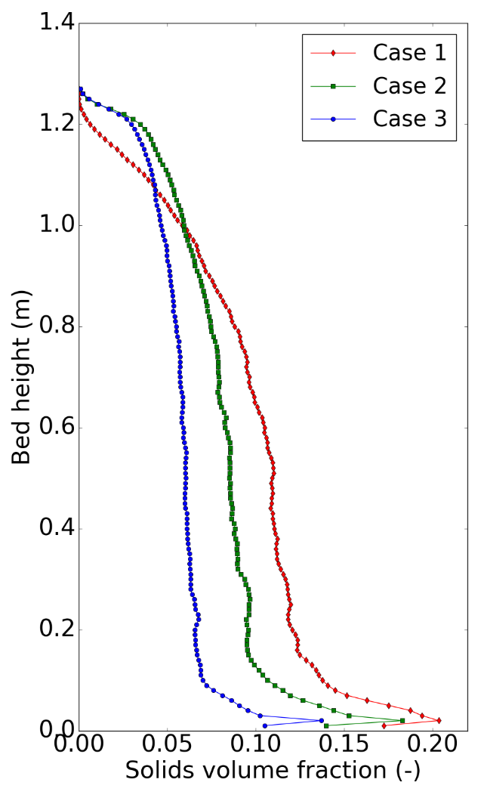
Further analysis
Solids volume fraction in the riser (S-shape)

Slide 16
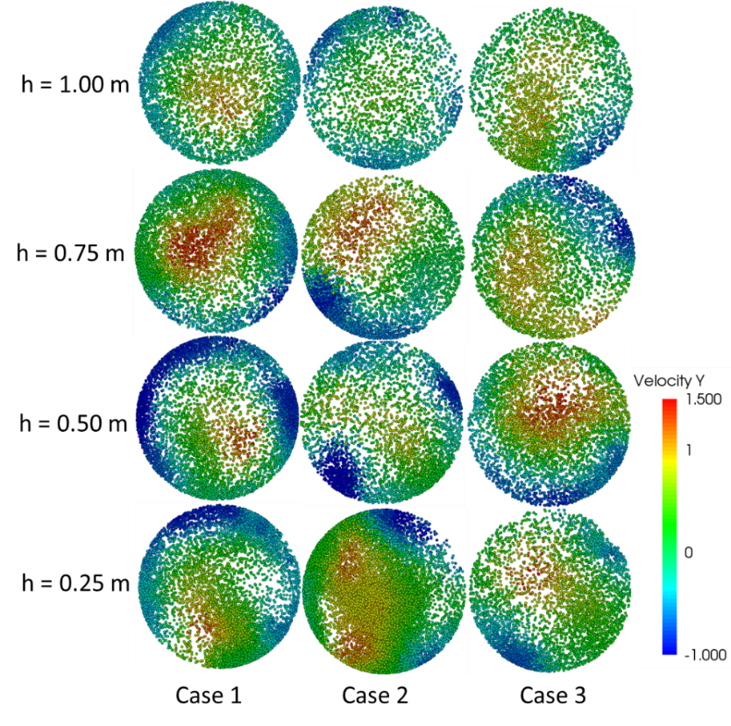
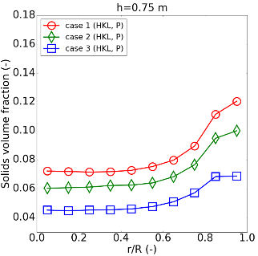
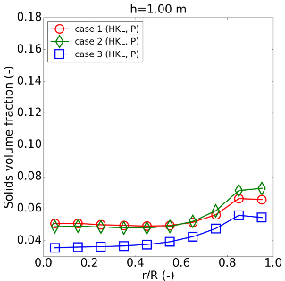
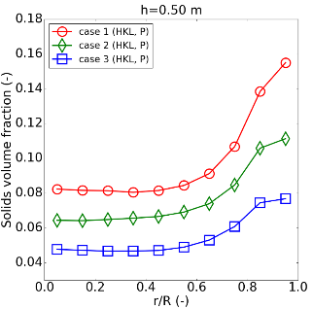
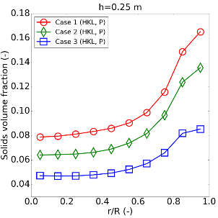
Further analysis
Core annulus structure

Slide 17
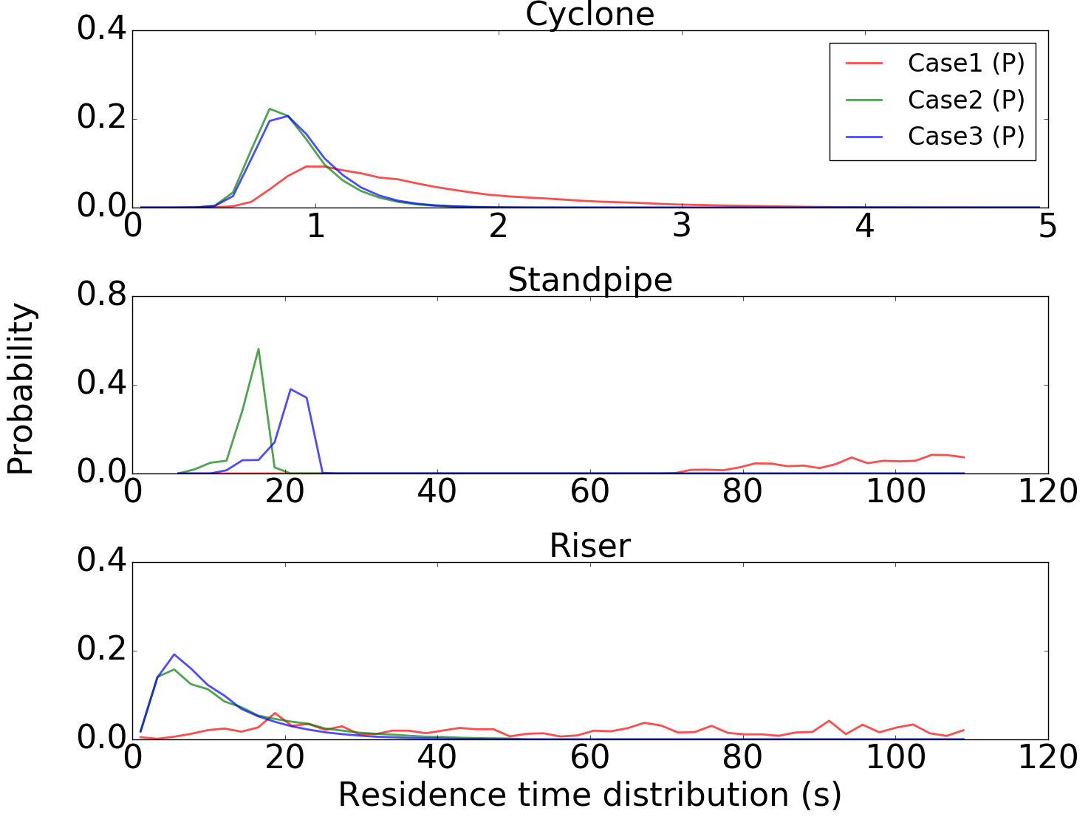
Further analysis
Residence time distribution

Slide 18
Conclusions
Detailed comparison of simulations and experiments for full-loop CFB systems have been performed over a range of operating conditions;
Simulation results and experimental data match very well for all operating conditions while keeping calibrated model parameters fixed;
The MFiX-DEM model has demonstrated its value as a high fidelity simulation tool capable of predicting key performance parameters for challenging CFB flow conditions.

Slide 19
Acknowledgements & Disclaimer
Acknowledgements
This technical effort was performed in support of the U.S. Department of Energy, Office of Fossil Energy's Advanced Numerical Simulation of Multiphase Flow through the National Energy Technology Laboratory under the RES contract DE-FE0004000. This research was also supported in part by an appointment to the National Energy Technology Laboratory Research Participation Program, sponsored by the U.S. Department of Energy and administered by the Oak Ridge Institute for Science and Education.
Disclaimer
This report was prepared as an account of work sponsored by an agency of the United States Government. Neither the United States Government nor any agency thereof, nor any of their employees, makes any warranty, express or implied, or assumes any legal liability or responsibility for the accuracy, completeness, or usefulness of any information, apparatus, product, or process disclosed, or represents that its use would not infringe privately owned rights. Reference herein to any specific commercial product, process, or service by trade name, trademark, manufacturer, or otherwise does not necessarily constitute or imply its endorsement, recommendation, or favoring by the United States Government or any agency thereof. The views and opinions of authors expressed herein do not necessarily state or reflect those of the United States Government or any agency thereof.

